Slide 1
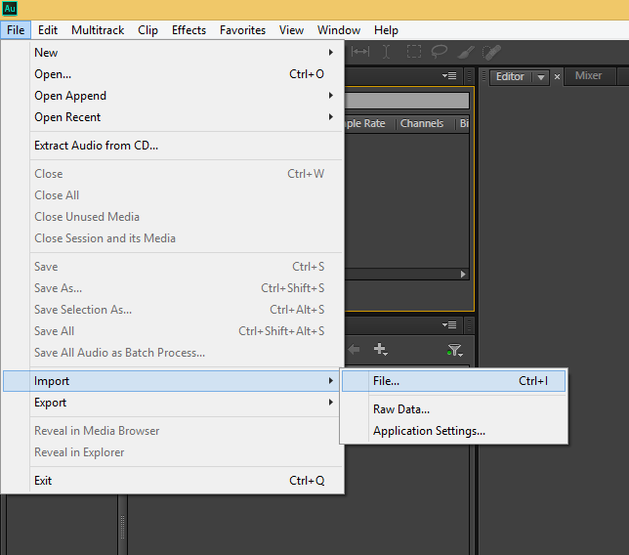
Open a new project and select File>Import>File… from the dropdown menu

Slide 2
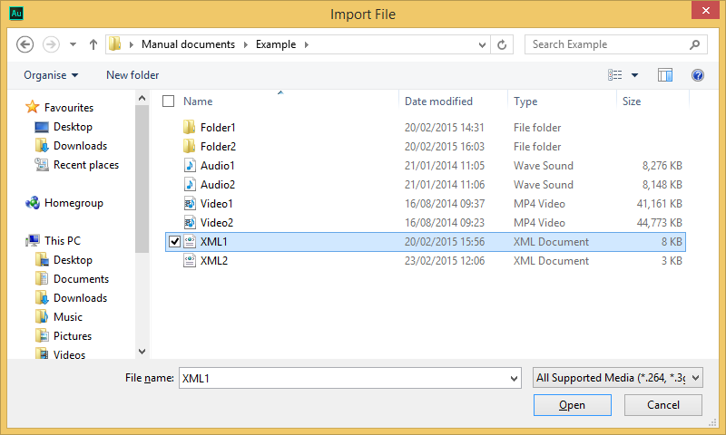
Select your MadCat/Spectator created XML and click Open

Slide 3
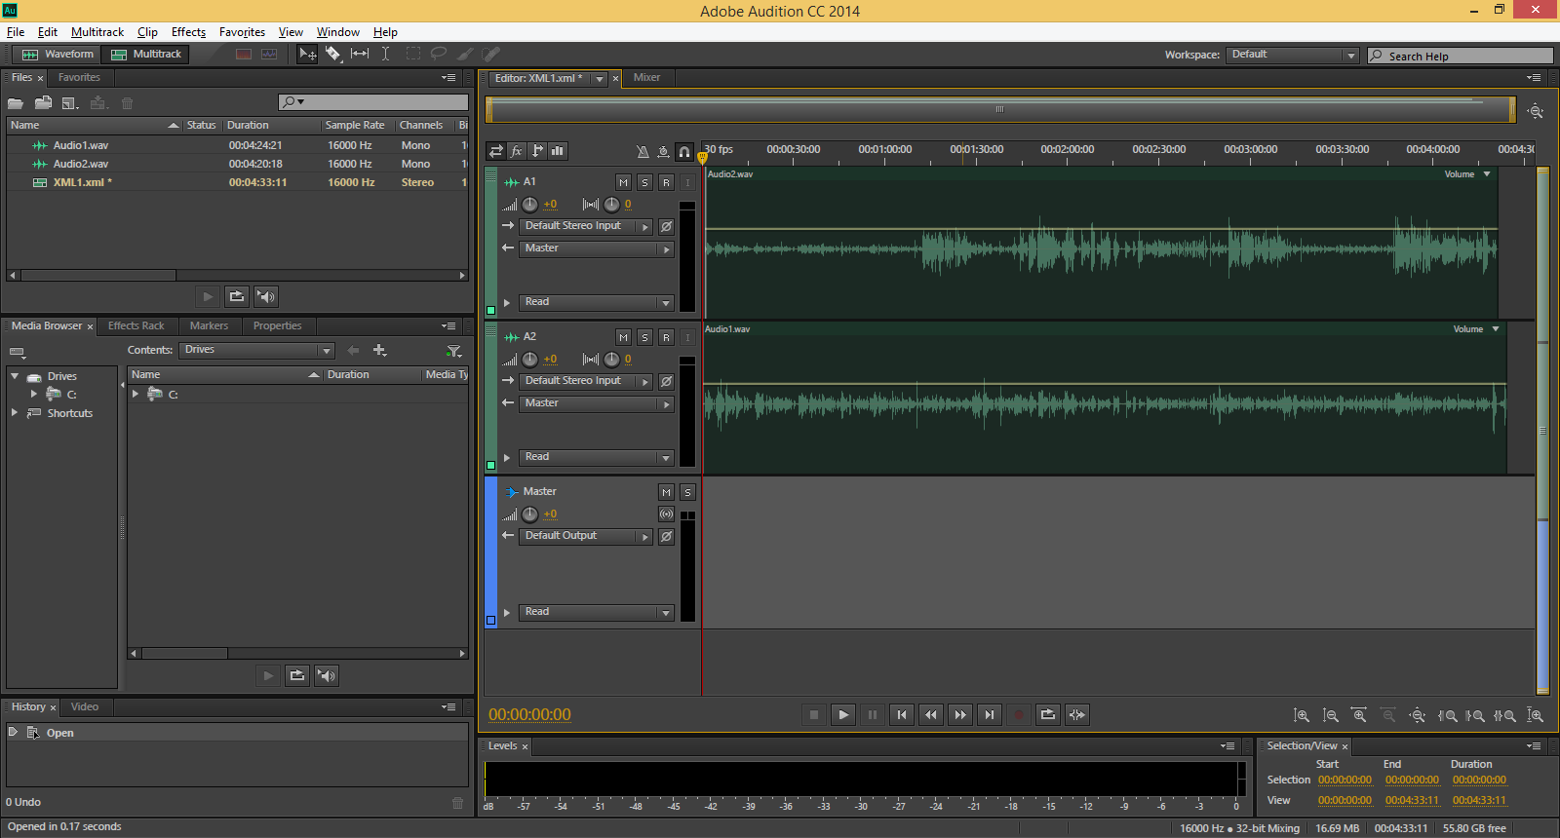
Each audio file will then be opened in Audition as an individual track and the tracks will all be synchronised according to the time offset found by MadCat/Spectator.

Slide 4
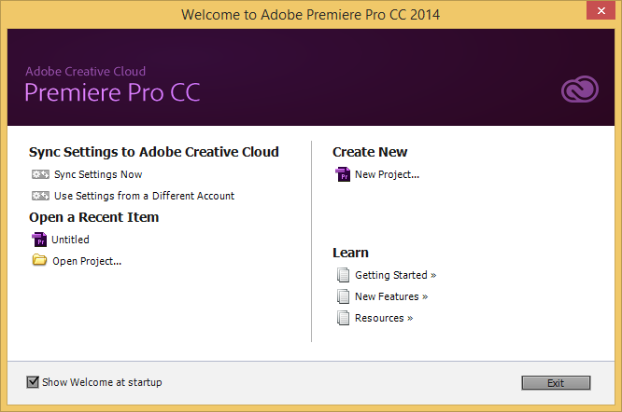
Open Premiere and create a New Project.

Slide 5
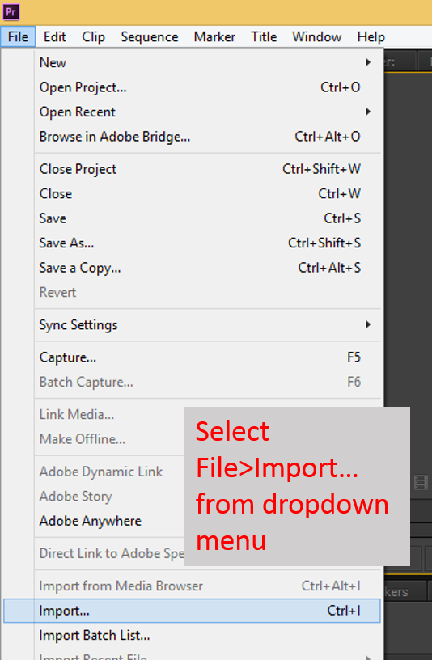

Slide 6
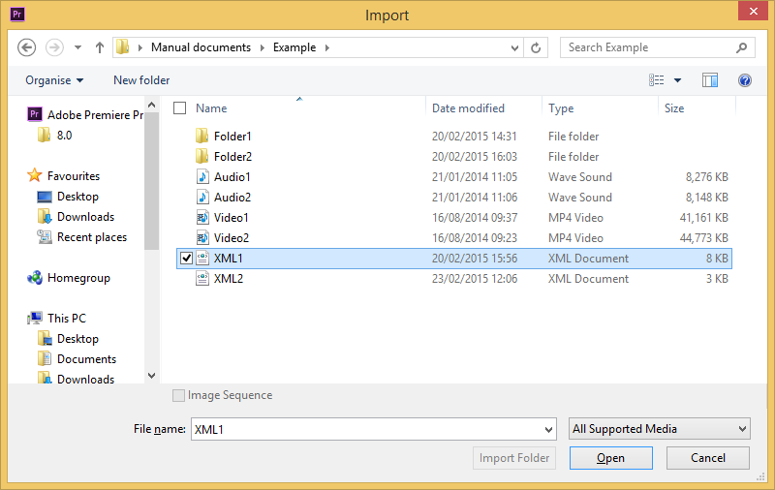
Select your MadCat/Spectator created XML and click Open

Slide 7
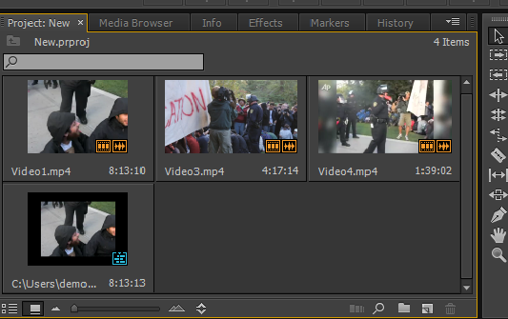
Once all files are loaded, double click the XML (with the blue symbol)

Slide 8
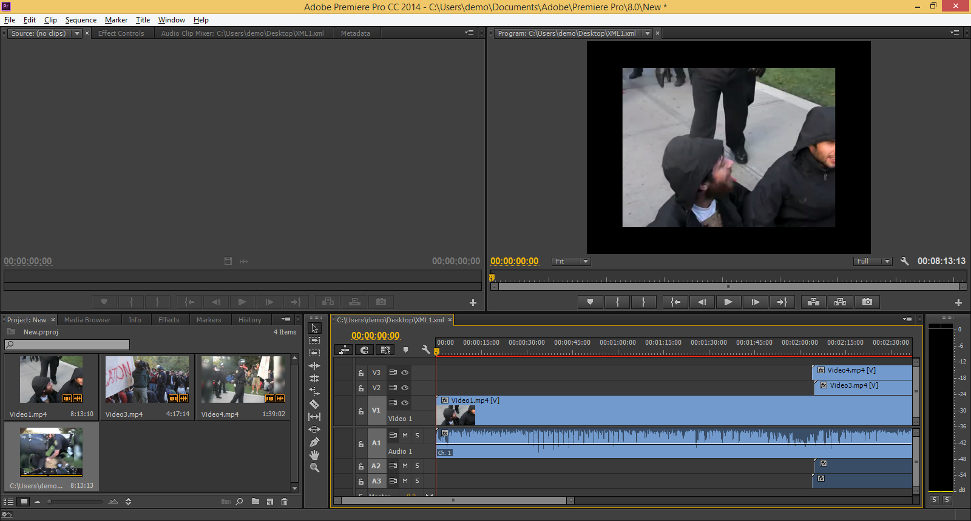
Your media files will then load into tracks and will be synchronised according to MadCat/Spectator found time offsets.

Slide 9
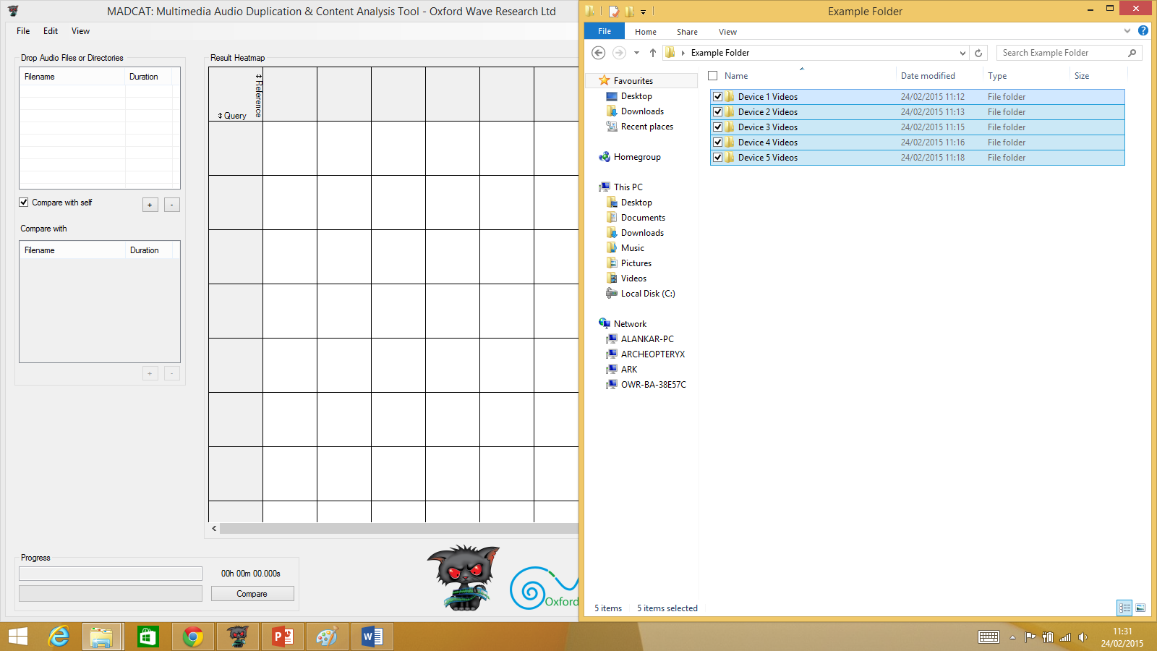
Ensure that videos you want to be grouped onto the same track in Premiere are contained within the same folder, and then drag the folders into MadCat’s Query file list box

Slide 10
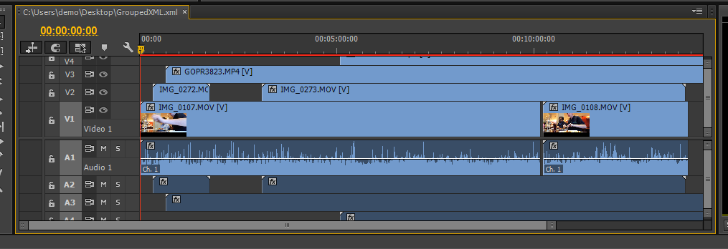
Videos within the same folder will occupy the same track

Slide 11
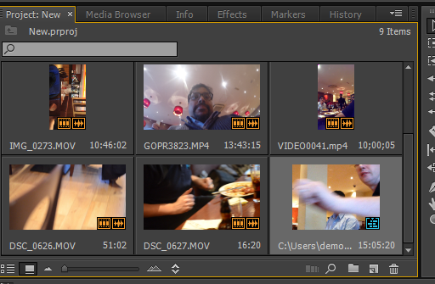

Slide 12
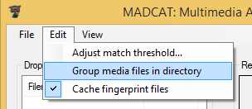

Slide 13
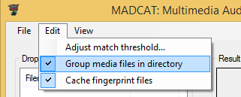

Slide 14
